Slide 1
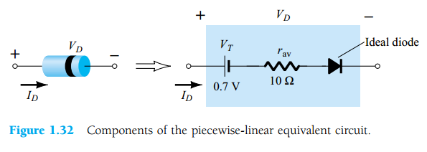

CO2015 Exercise on Diode

Slide 2
Diode Equivalent Circuit

Slide 3
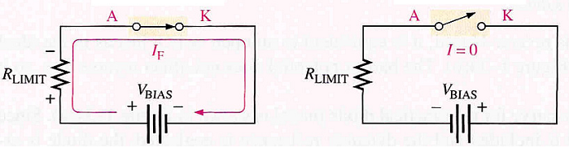

Ideal Diode Model
Works as a switch
Forward bias (switch is close)
Reverse bias (switch is open)
Threshold battery voltage and internal resistance are ignored.
Forward bias
Reverse bias

Slide 4

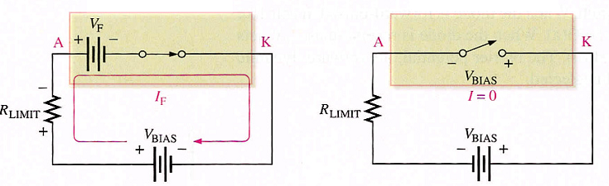
Practical Diode Model
Forward bias
Reverse bias
Constants
Silicon Diode: V_{F} = 0.7V (V_{F} = V_{BIAS} if V_{BIAS} < 0.7V)
Germanium Diode: V_{F} = 0.3V (V_{F} = V_{BIAS} if V_{BIAS} < 0.3V)

Slide 5
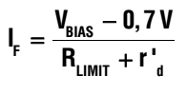

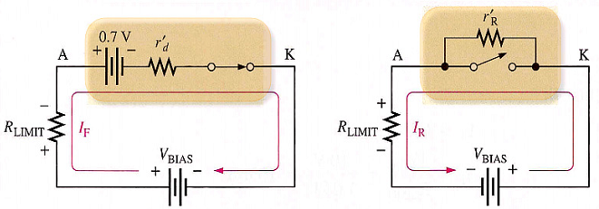
Complete Diode Model
Forward bias
Reverse bias

Slide 6

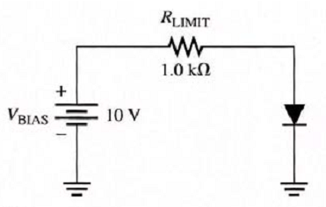
Exercise 3
Given circuit
Forward bias voltage V_{F} = 0.7V
Internal resistance
Determine V_{F}, I_{F} and V_{RLIMIT} for three diode models
Ideal diode model
Practical diode model
Complete diode model

Slide 7
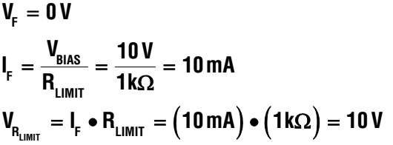
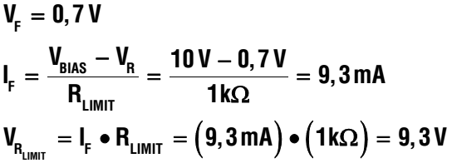
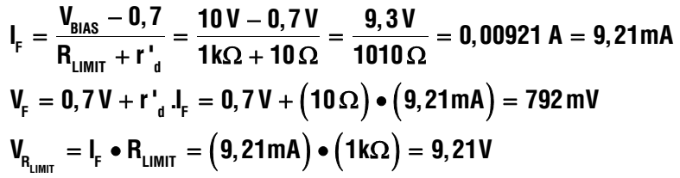
Solution 3
Ideal diode model
Practical diode model
Complete diode model

Slide 8
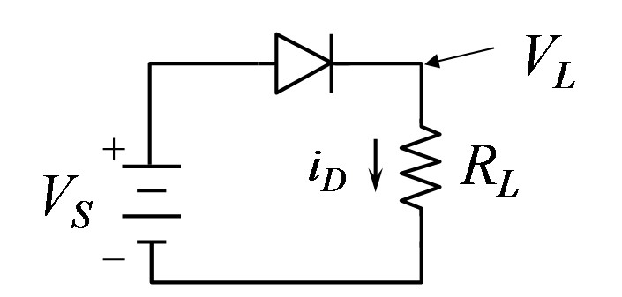
Exercise
Analyze the circuit by using the diode practical model.
V_{S} = 5V and the current (i_{D}) in the circuit is 1mA.
What is the value of R_{L}.
The dropdown voltage of the diode is 0.7V
Notes:
VS = 0.7 + id * RL

Slide 9
Exercise
V_{CC}
When R = 230 Ohm, V = 0.68V
When R = 150 Ohm, V = 0.69V
Determine the internal resistance of the diode.
V_{CC} = 5V for both cases
Notes:
5V = I1 * 230 + 0.68 -> I1 -> r = 0.68/I1
5V = I2 * 150 + 0.69 -> I2 -> r = 0.69/I2

Slide 10
Exercise
V_{CC}
Determine the dropdown voltage of the diode and its internal resistance with V_{CC} = 12V, R = 220 Ohm and I = 51.63mA51.

Slide 11
Exercise
1K
The voltage supply is 9V, the dropdown voltage of each diode is 0.7V. Determine the current in the circuit
Notes:
I = 9 – 0.7-0.7/ 1k = 7.6mA

Slide 12
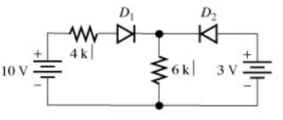
Exercise
Analyze the circuit using ideal diode model

Slide 13
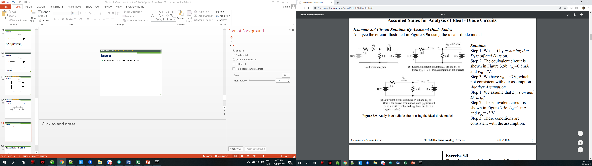
Answer
Assume that D1 is OFF and D2 is ON
Assume that D1 is ON and D2 is OFF
Notes:
Vd = 7V -> not consistent with assumption
VD2 = -3V -> correct

Slide 14
4K
D1
D2
10V
6K
3V

Slide 15
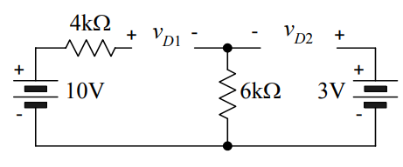
Exercise
Explain that D1 and D2 are off is not a valid assumption
Notes:
D1 and D2 are off is not valid as their voltages are positive

Slide 16

Exercise
Show that D1 and D2 are on is not valid also

Slide 17
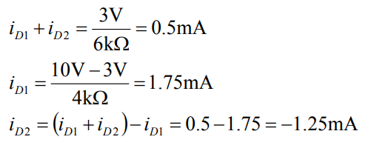
Answer

Slide 18
Midterm (60 mins – Closed Book)
25/05/2020
Multichoice + Written
Chapter 1: Basic Electronic Components
Deterimine the resistor values (4-band colors, 5-band colors)
LEDs connectors (Serial + Parallel)
Chapter 2: Diode
Diode Principles and Models
Applications using Diodes
Chapter 3: BJT (npn)
Amplifier Coefficient, Applications
Cutoff, Saturation and Amplifier modes
Vbe = 0.7 (for default)

